Slide 1

Classification Project: Predict Liver Disease
Team Members :
Ananthalakshmi Saripalle
Mr.Bhavin Sutariya
Mr. Saurabh Vilas Mestry
Mr. Vikram Dattatray Yewale.
Mr. Rohit Vilas Shewale
MEENUGA JYOTHI
<Mentor Name : Varun Sir

Slide 2
Business Problem:
Classification Project: Predict Liver Disease.
Objective:
The variable to be predicted is categorical (no disease, suspect disease, hepatitis c, fibrosis, cirrhosis).
The dataset is having incidents raised by customers. Which contains an event log of an incident management process extracted from a service desk platform of an IT company

Slide 3
Project Architecture / Project Flow :
Business Problem Understanding
Data Acquisition & Understanding
Exploratory Data Analysis
Feature Engineering
Model Building
Model Deployment

Slide 4
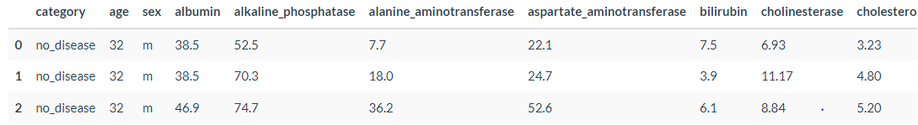
Data set details :
Number of variables | 13
Categorical Variable | 3
Numeric Variable | 10
Number of observations | 615
Missing cells | 30
Missing cells (%) | 0.4%
Duplicate rows | 0
Target Variable have 5 categories (no disease, suspect disease, hepatitis c, fibrosis, cirrhosis)

Slide 5
Exploratory Data Analysis (EDA) and
Feature Engineering

Slide 6
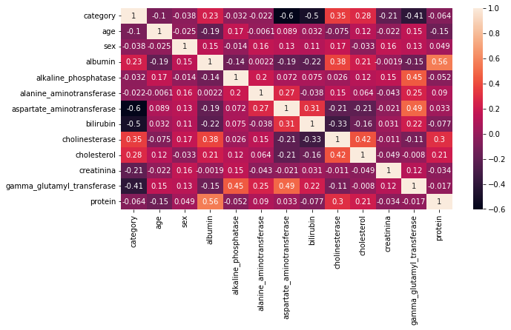
Exploratory Data Analysis (EDA) :
protine has a high cardinality (199 Distinct Value ).
aspartate_aminotransferase is highly overall correlated with gamma_glutamyl_transferase

Slide 7
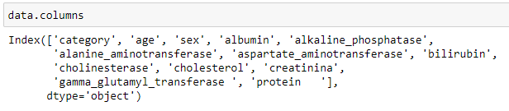
Exploratory Data Analysis (EDA) :
There is Whitespaces in Column names
Removing the whitespaces from column name.

Slide 8
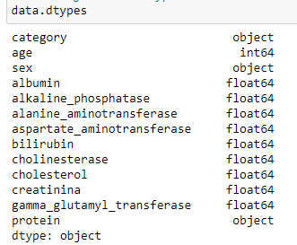
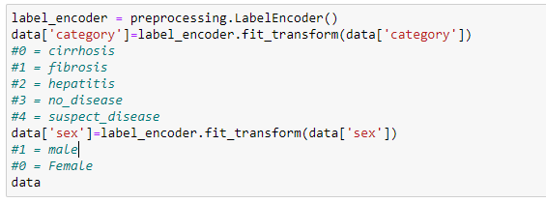
Exploratory Data Analysis (EDA) :
category, sex, protein column has Object datatype
Changing the datatype of Category Column (Target Variable) and sex column.

Slide 9
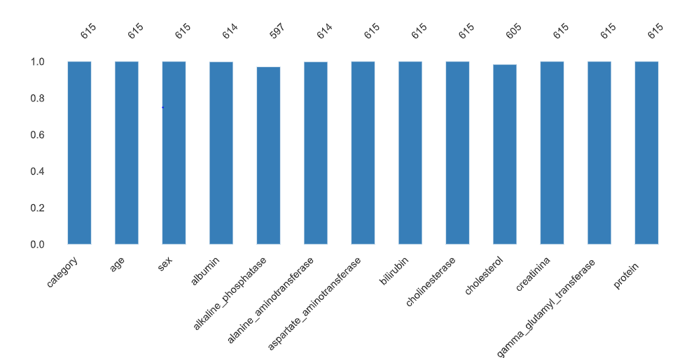
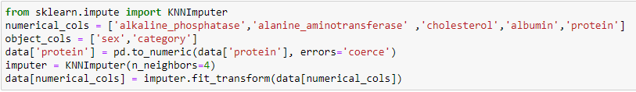
Exploratory Data Analysis (EDA) :
Missing Values:-
0.4 % missing cells in Data set
albumin, alkaline_phosphatase, alanine_aminotransferase and cholesterol column contains missing Values
Replace the missing values using KNN Imputer

Slide 10
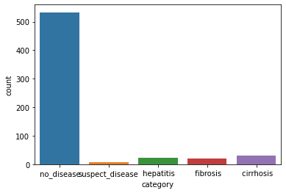
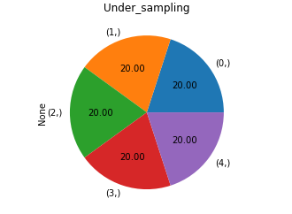
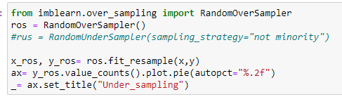
Exploratory Data Analysis (EDA) :
Category is highly imbalanced
Balancing the dataset

Slide 11
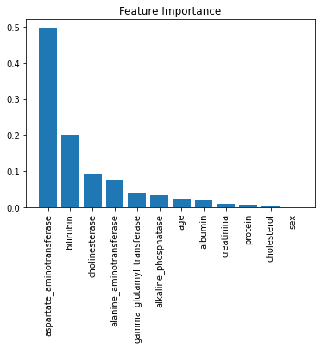
Feature Engineering :
Finding the important Features using Decision Tree Regressor
Sex, Cholesterol, protein are less important for model Building

Slide 12
Model Building

Slide 13
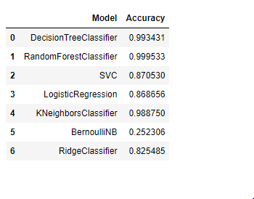
Model Building :
Training multiple models and check their accuracy
Random Forest Classifier gives high accuracy so we finalize this model.

Slide 14
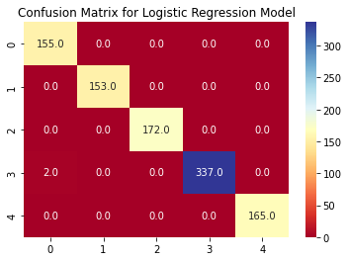
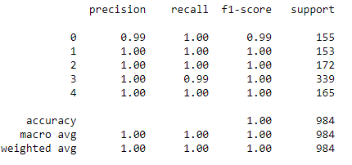
Model – Random Forest Classifier
Data set details
Algorithm details and configuration
Independent Variable = 12,
Target variable = 1
Size of data = 3280 x 13
max_depth = 20
min_samples_leaf = 5
n_estimators = 25
n_jobs = -1
random_state = 42
Data Partition details
Training data : 2296 x 13
Testing data : 984 x 13

Slide 15
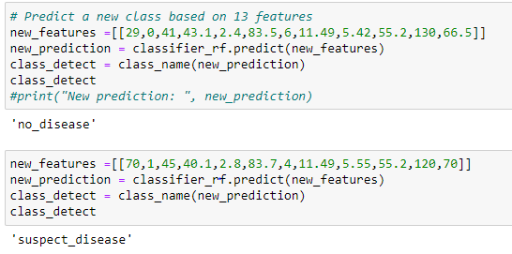
Model Predictions :
Predict using new class :
Craete a new feature and predict their Category

Slide 16
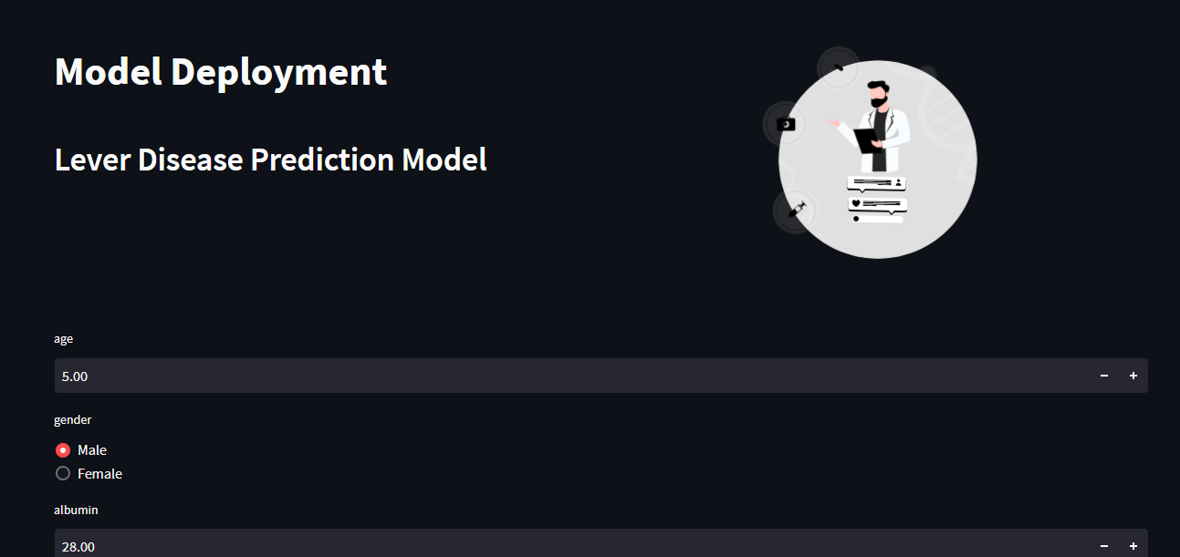
Model Deployment :
Model Deployment using Streamlit
Create a script file in .py format and run in command prompt

Slide 17
Challenges faced?
Data is highly imbalanced (65%)
Need to know which features is important
Model selection for batter accuracy.
How did you overcome?
For Balancing the dataset import imblearn library and Use Random Over Sampling Method.
For Feature selection use sklearn library and import Decision Tree Classifier, plot them in bar plot to see important features
Run the multiple Models and see their accuracy and compare their accuracy.

Slide 18
Thank you

